Slide 1
Austin Traffic Fatalities Analysis
2013-2018
By: Jennifer Lawless, Jie Bai, Jorge Cavazos, Tristan Serigny

Slide 2
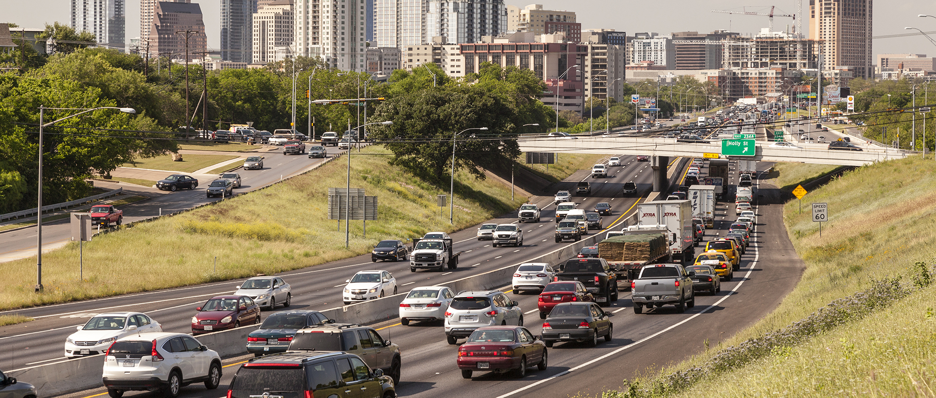
Initial Considerations
Map the specific locations of Austin traffic fatalities
Determine the most common cause, vehicle type and time of day involved in these accidents
Compare the total number of these accidents among each year over the six year span our data set provides
Determine the percentage of these accidents occurred while the driver was wearing a seat belt and vice versa
Determine the percentage of these accidents occurred while the driver was sober and vice versa

Slide 3
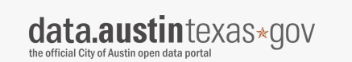
Dataset Utilized
City of Austin Open Data Portal:
https://data.austintexas.gov/browse?limitTo=datasets&q=traffic+fatalities&sortBy=relevance

Slide 4
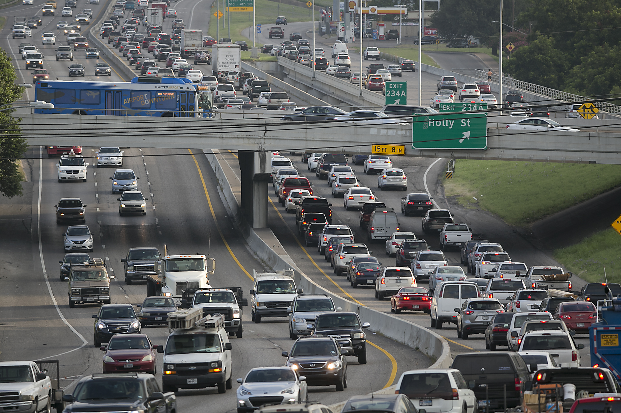
Data Limitations
2012 Data Limitations
Helmet VS No Helmet Limitation
Seatbelt Correlation Limitations

Slide 5
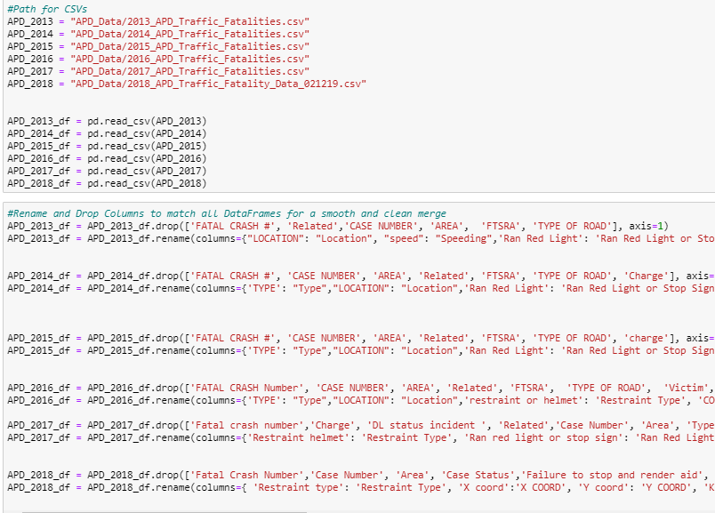
After Finding the Data
Creating a GitHub Repository
Downloading the CSV files
Starting a Jupyter Notebook
Setting CSV pathways
Creating Pandas DataFrames
Renaming Column Rows

Slide 6
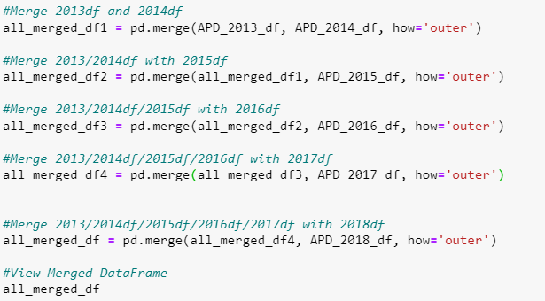
Merging the DataFrames from Each Year

Slide 7
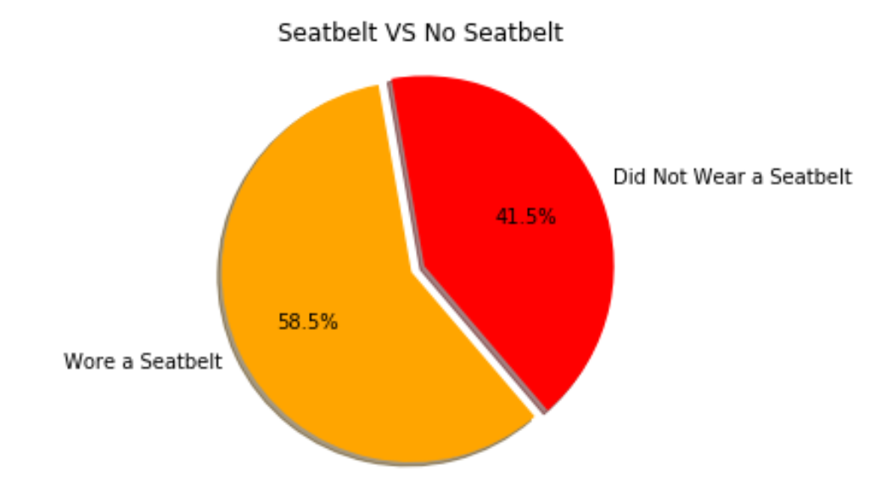
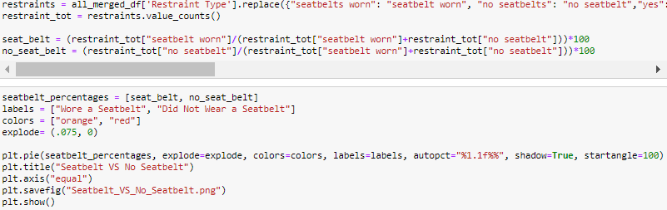

Slide 8
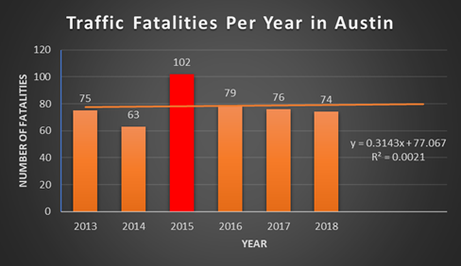

Slide 9
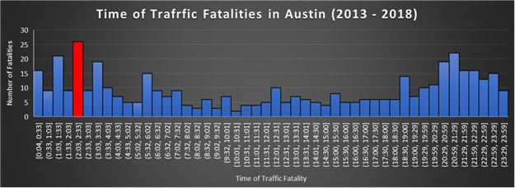

Slide 10
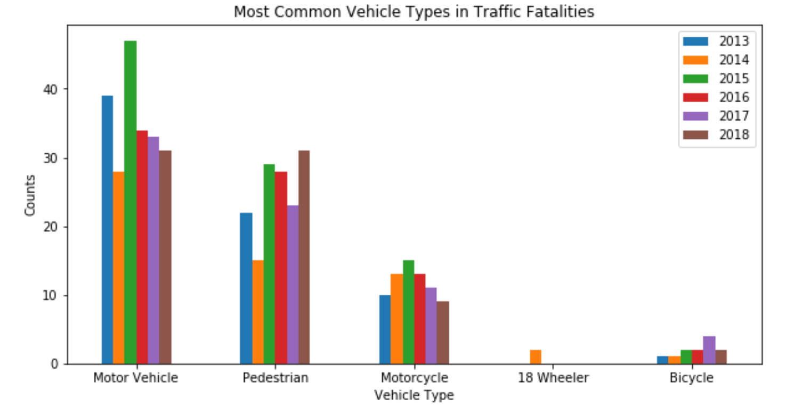

Slide 11
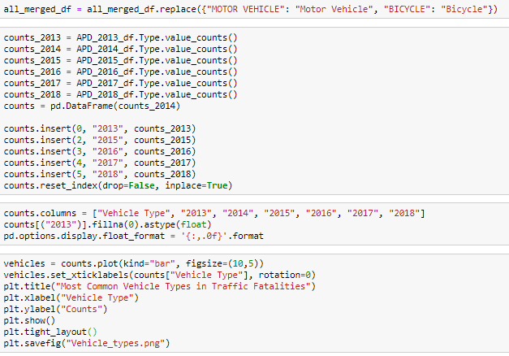
Most Common Vehicle Type

Slide 12
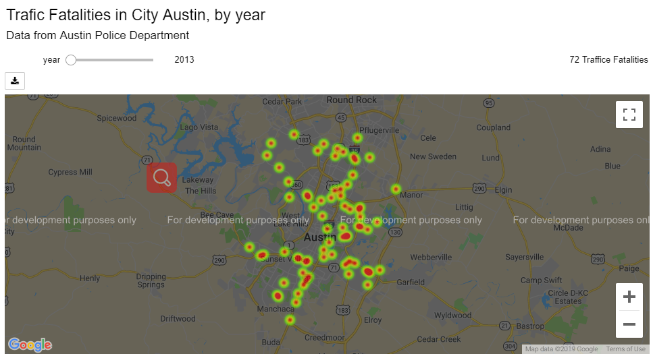

Slide 13
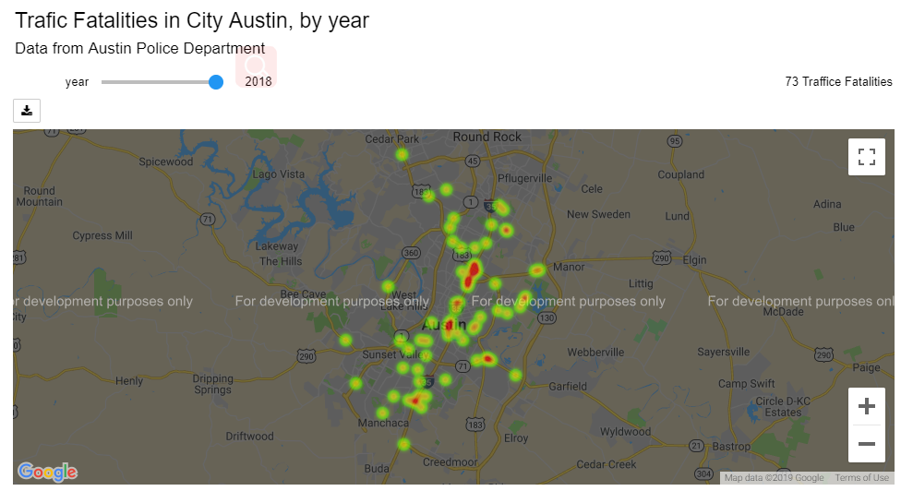

Slide 14
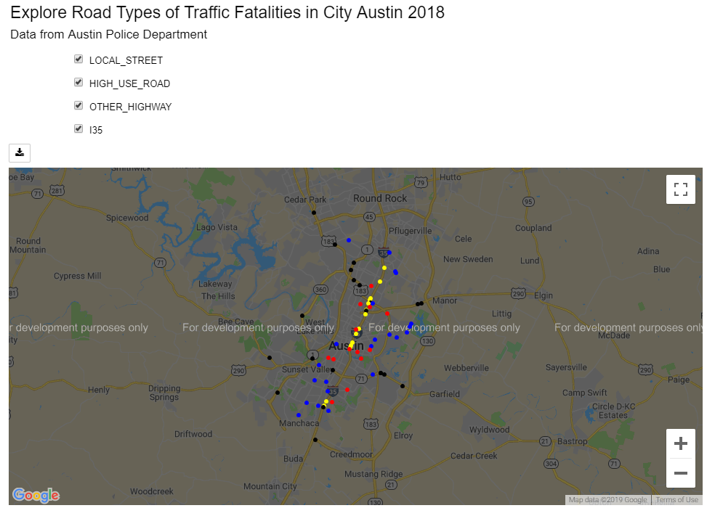

Slide 15
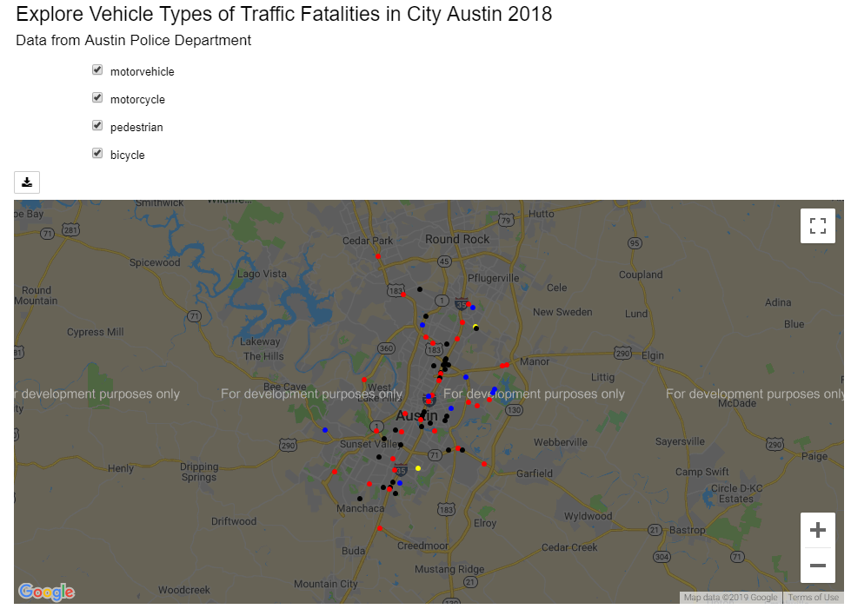

Slide 16
Conclusion
• The number of traffic fatalities in Austin appear to be decreasing over the last few years for motor vehicles and motorcycles but appear to be trending upwards for pedestrians and bicyclists.
• Austin is growing in population every day and we all know traffic seems to be getting worse, and with more people, unfortunately, comes the higher risk of accidents.

